Slide 1


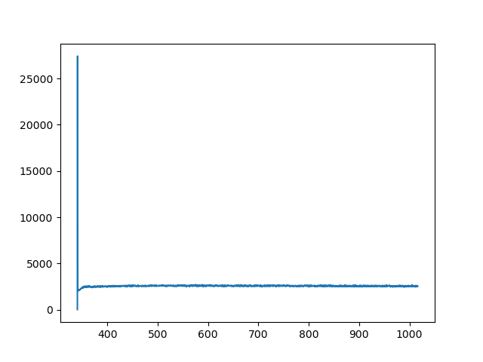
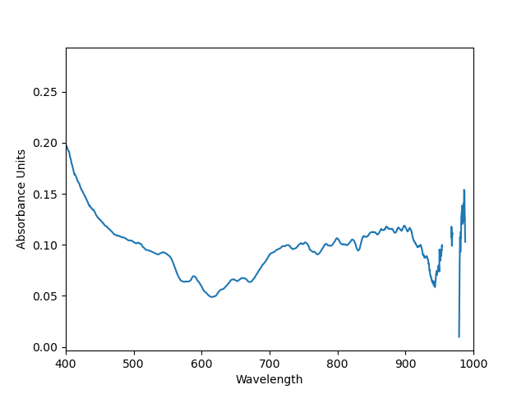
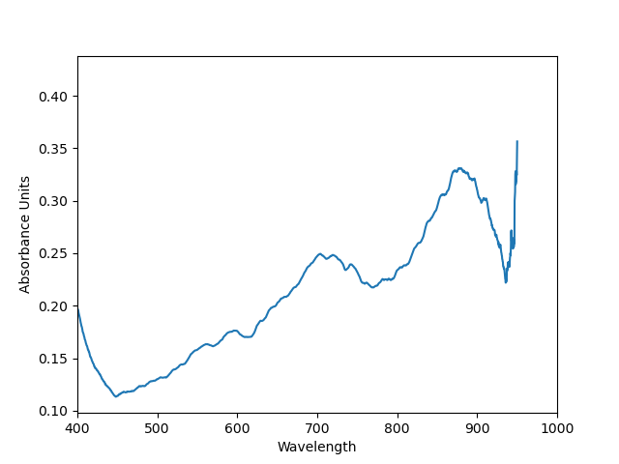
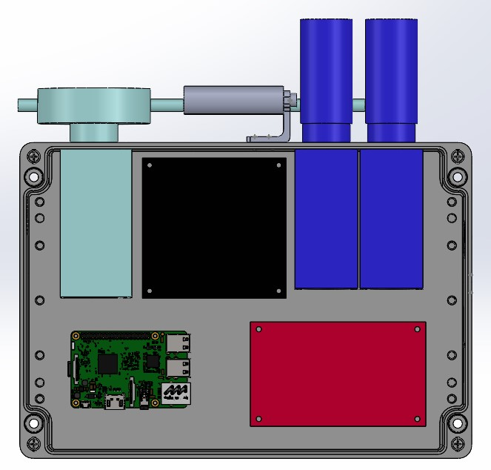
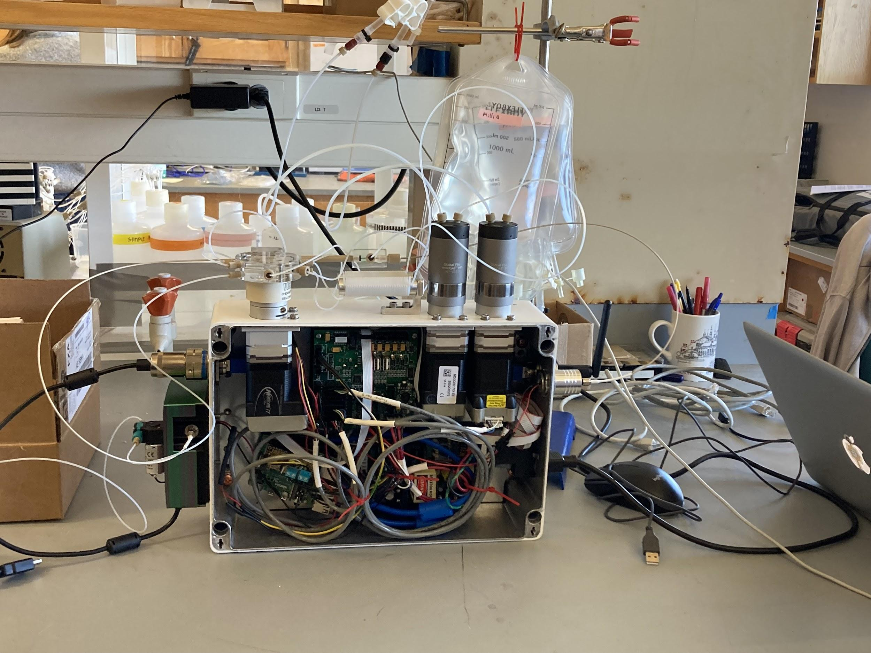
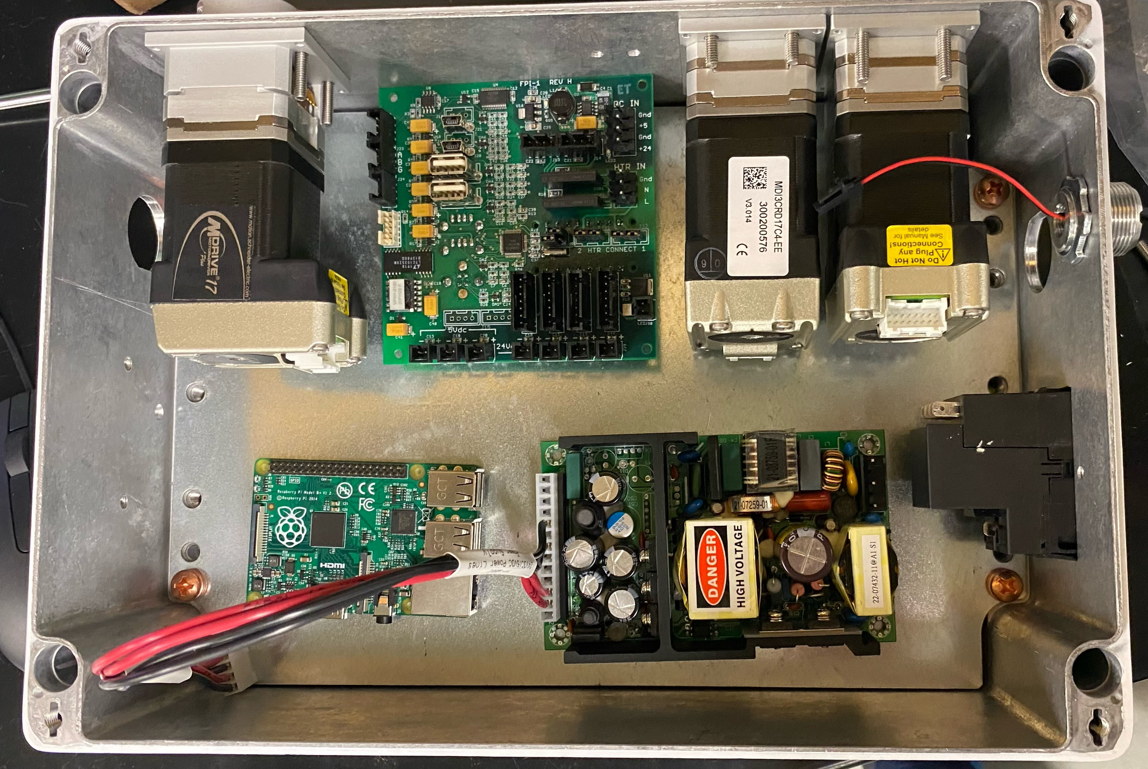
pFIONA Programmable Flow Injection Ocean Nutrient Analyser
Project team: Andrew Silva, Tracy Hunter, and Timothy Ly,
Faculty Advisor: Maxime Grand, Crystal Han, Farzan Kazemifar, Ed Cydzik
Project Sponsor: Moss Landing Marine Lab
BACKGROUND AND MOTIVATION
Dark Scan (Calibrate Zero)
Reference Sample (0.2 micromol/kg)
Unknown Sample (micromol/kg)
Analysis of Phosphate (PO4) as an Indicator of Eutrophication
Quantify Agriculture Impact on Ocean Nutrient Levels
Reduce Energy Use and Overall Cost of pFI Analysis
Democratize pFI Analysis of Water Samples
Produce Higher Resolution Time & Location PO4 Analysis
Our requirements are a limit of detection on the order of 50 nmol/kg and an upper limit of quantification of 4 micromol/kg.
Range of Wavelength for Phosphate Analysis
Range of Wavelength for Phosphate Analysis
Absorbance Units
OBJECTIVES
Wavelength
Flow Cells
MilliGat
Pump #2
Reverse Engineer Lab-Based Instrument Sans Software
Deployable, Wireless, Remote, and Realtime pFI Analysis
Withstand Exposure to Wet, Salt Air Environments
Watertight Housings for Components and Reagents
Develop and Test Firmware, Software, Enclosure, & Housing
Integrate Auxiliary Pump and Light Source Into Enclosure
Chem on
Valve
(CoV)
Flow Cells
Chem on
Valve
(CoV)
MilliGat
Pump #1
MilliGat
Pump #2
WiFi Antenna
Light Source
Selector
Valve
Comm. Board
MilliGat
Pump #1
Selector
Valve
Comm. Board
USB Bulkhead
Aux. Pump
Power Supply
Microcomputer
Power Supply
Microcomputer
Spectrophotometer
METHODS
RESULTS AND LESSONS LEARNED
Raspberry Pi Controlled System Using Python, IOT
Control 3 Nema 17’s Via Serial to RS485 Bridge
3D Modeling Enabled Iterative Design Prior to Manufacturing
Rapid Prototyping Utilizing 3D Printing and CNC Machining
Research, Documentation, SolidWorks, Orcad, Github
Benchtop Prototype Allowing Iterative Testing & Development
3D Models of Components + 3D Printed Hole Patterns
Trial and Error, Debugging With Users
Wireless, Deployable, Splashproof Instrument Accessible Via Internet
Design Specifications Hierarchy Determined By Environment & Process
Interfacing With Linux Based Systems & Developing Firmware
Soft Skills Interfacing With Cross Discipline Users, Advisors, Researchers
Automating Microfluidic Handling Using Python Scripts
Understanding of Serial and RS485 Communication Standards
Leveraging 3D Printing, Iterative Design, and Off-The-Shelf Components
Special Thanks to our Advisors, Sponsor, Lin Jiang, Winncy Du, Marine Lebrec, Cameron Hayes, and the Staff of SJSU’s Mech. Eng. Dept.

